Slide 1
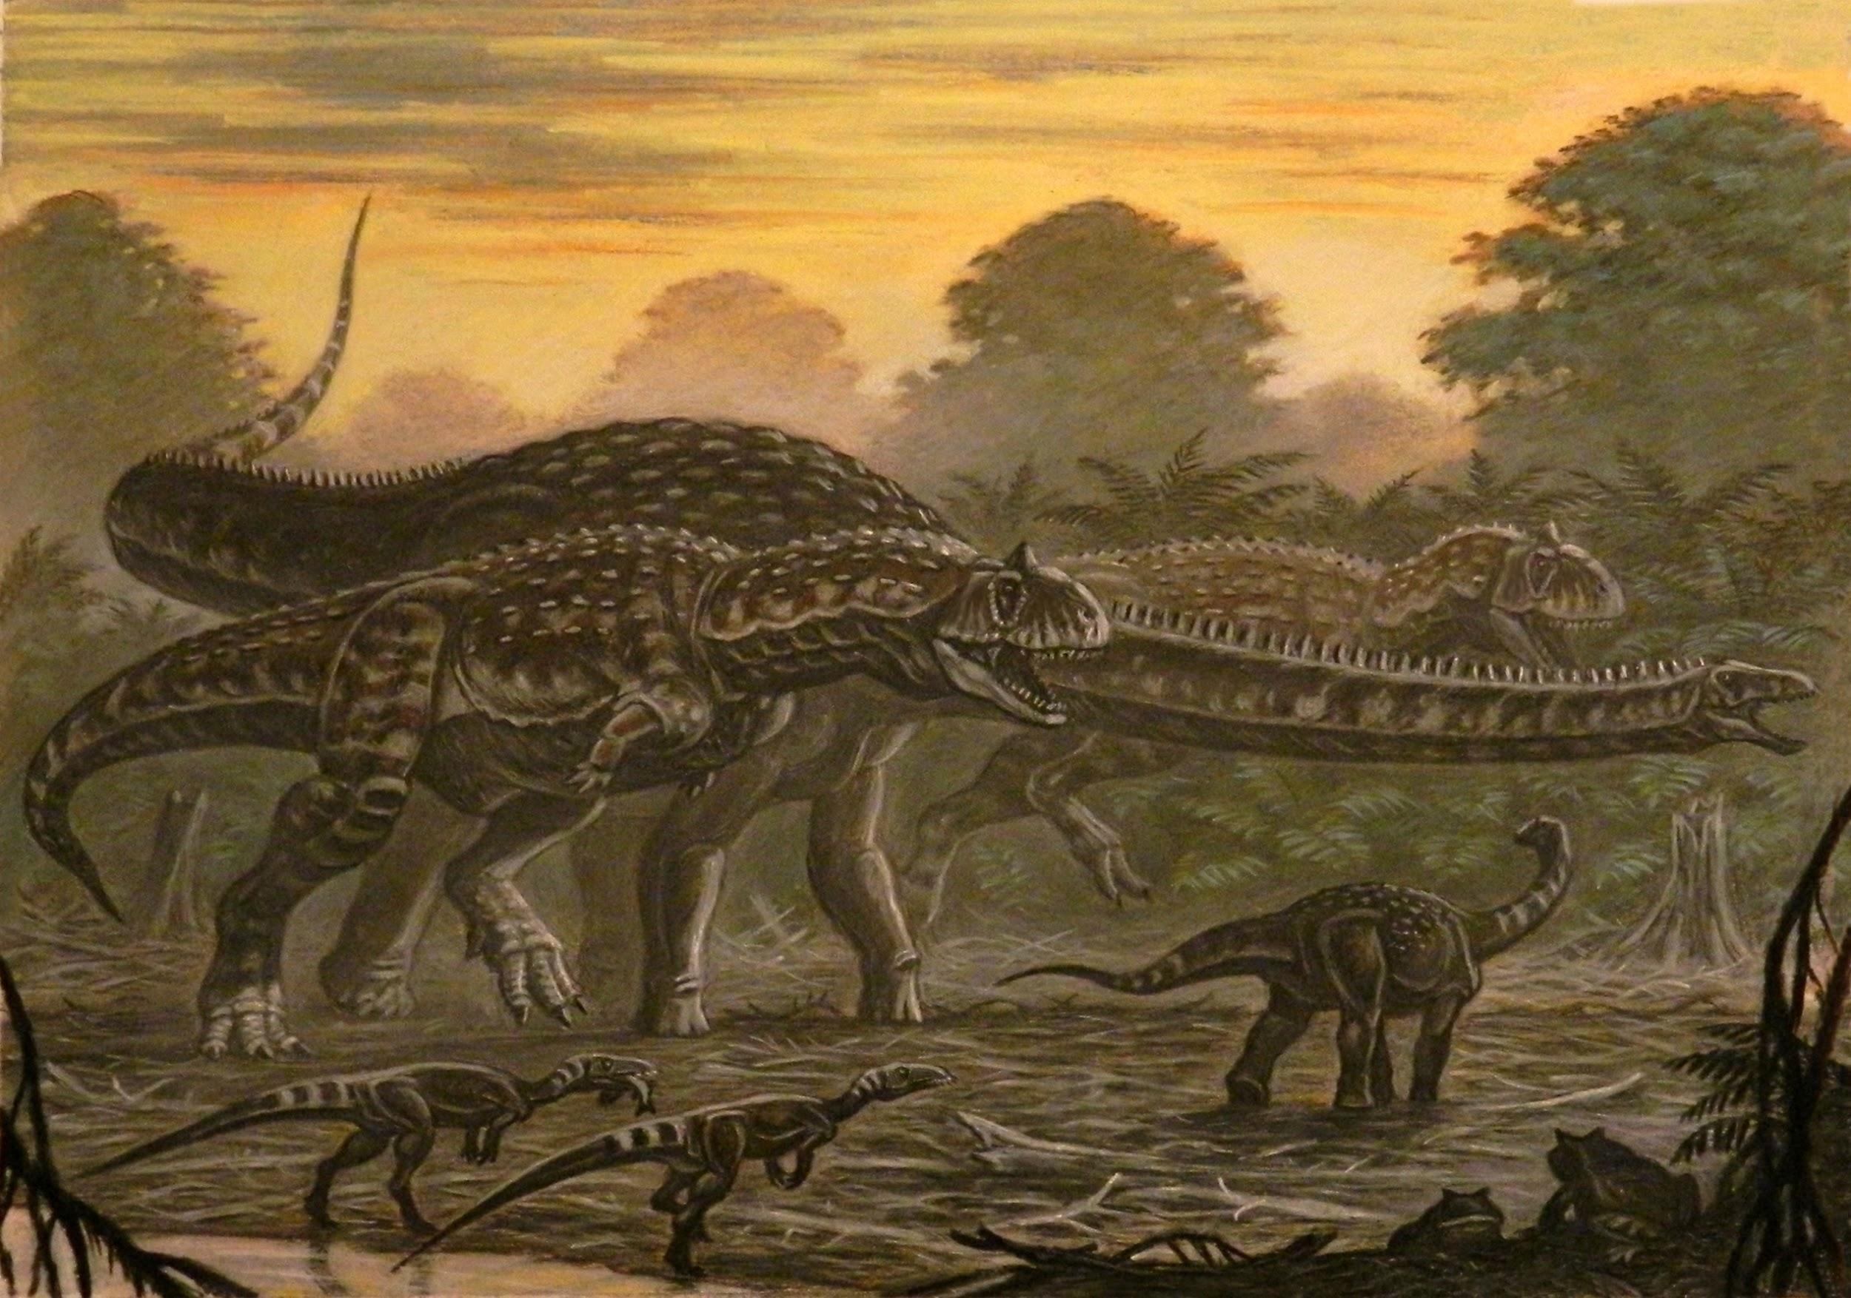
Brain 2
By Stephanie, Ilana, Lin, Nushera

Slide 2
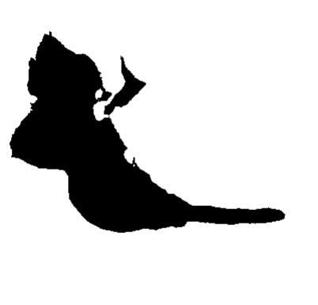
Observations
Large portion juts out under skill, maybe have a larger more muscular beak
Doesn’t have as large floccular lobe like most birds (N)
Almost detached part of brain most modern birds lack (L)
Large portion juts out under skull, maybe have a larger more muscular beak (I)
Very long olfactory bulbs (S)
Big divot in the brain
Long olfactory bulbs
Doesn’t have as large floccular lobe
almost detached part of brain

Slide 3
Prediction what it is (s)
We predict that our brain is Non Avian Dinosaur because:
Has a long olfactory bulb compared to bird short one
Looks more similar to the avian brains than bird brain
Cerebellum doesn't look as big as birds brain cerebellum do
Can’t identify were our optic lobe is
What we see to be the puerperium is way too big to be a bird

Slide 4
Prediction on how smart it is (L)
This non-avian smart, but not quite as smart as avians as it…
Has a similar brain structure with modern day birds
Survived through the mass extinction through adaptation and evolution
Brains are generally smaller than modern day birds, and changes between allowed for the modern day birds increase in intelligence
Many different types of non-avians adapted to live in different environments

Slide 5
Project Goals (N)
Our goal was to decide whether this mysterious brain is a bird brain or a non-avian dinosaur brain.
We also made predictions on how smart our animal is and used coding to prove that.
Create function to help find what kind of brain we have
Why Code? (I)
Help create visualization
Can do multiple things at once
Has libraries that help filter and show our data
Can repeatedly use code for different data

Slide 6
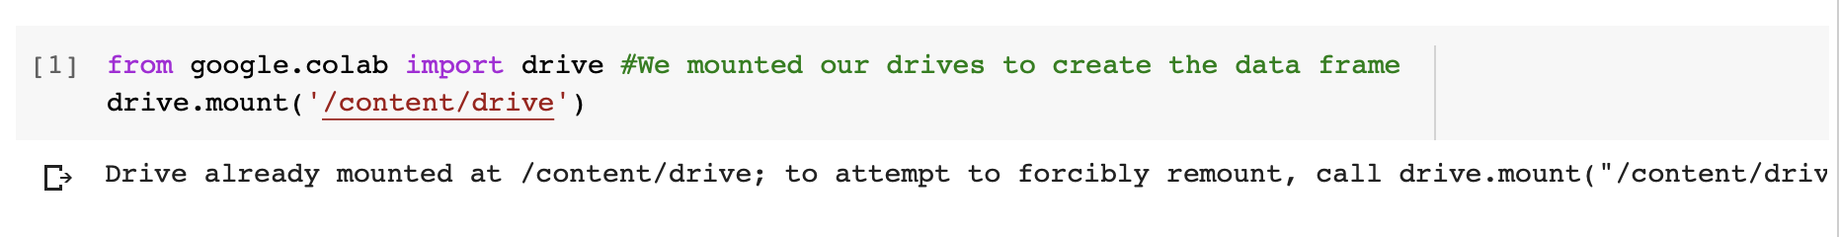

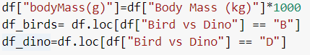
Importing & Creating DF (I)
Importing google drive to access our csv file and Brain data
Importing libraries to help filter, calculate and show our Data and created a data frame for our data
Creating DF so it easier to call specific data
Notes:
Fisrt line creating data frame and changing units by multiplying it to by a thousand
Acesses it,Sect. it by using .loc
scond line is birds
Third line is only dinasours

Slide 7
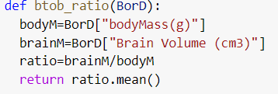
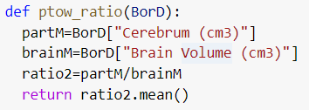
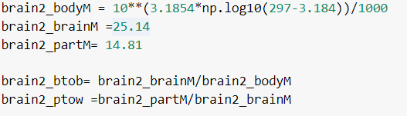
Finding Ratios (N)
This is a function we used to help find the brain to body mass ratio of either the dinosaur data or bird data
This is a function we used to help find the Cerebrum to brain ratio of either the dinosaur data or bird data
This cell was used when we wanted to find the brain to body mass ratio and the cerebrum to brain ratio of the brain we were given

Slide 8
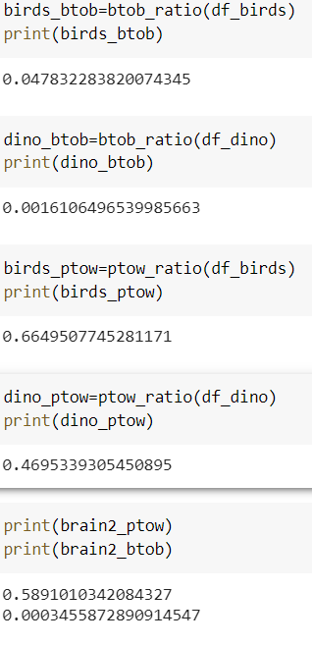
Creating Variables (S)
We created variables for our ratios to make it easier to code our function and create our graphs

Slide 9
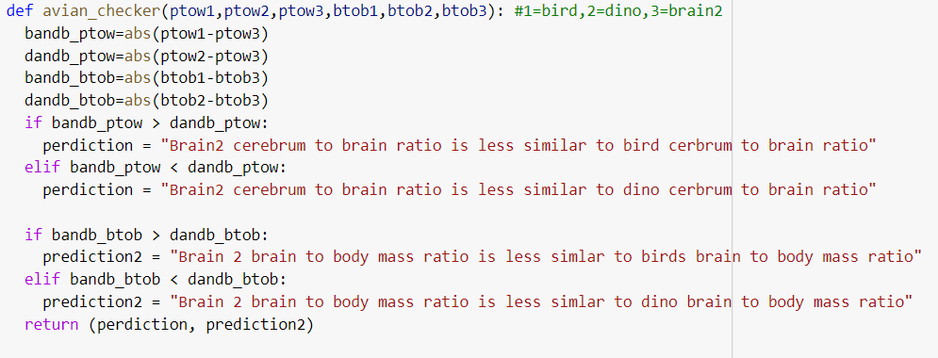
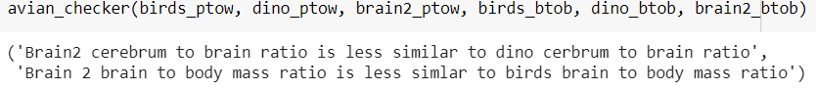
Checking if Brain 2 was a Bird or Dinosaur (S)
created our function and put our parameters in
assigned variables that found the absolute difference between ratios
used if statements to create our predictions using the difference in ratios
returned our predictions to complete our function

Slide 10
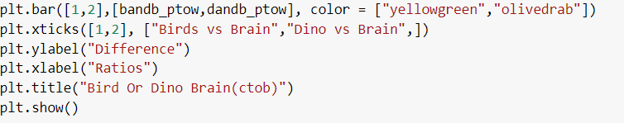
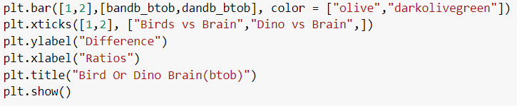
Bar Graph (L)
This the code for creating our Bar Graph for cerebrum to whole brain ratio to show which was our brain most similar to.
This the code for creating our Bar Graph for brain to body mass ratio to show which was our brain most similar to.

Slide 11
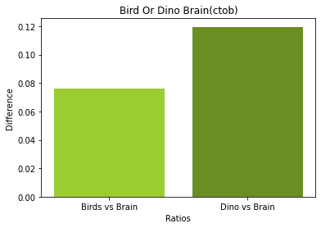
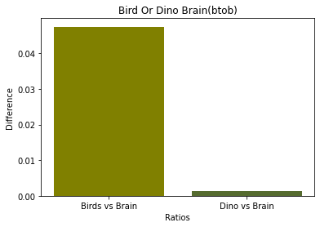
Bar Graph Cont. (L)
This bar graph shows that our cerebrum to whole brain ratio was more similar to the birds than the dinosaurs because we have a bigger difference between the dino and our brain than the birds
This bar graph shows that our brain to body mass ratio was more similar to the dinosaurs than the birds because we have a bigger difference between the bird and our brain than the dinosaurs

Slide 12
Scientific Conclusions (L)
Visually, brain number two has a few differences from a modern day bird brain and more closely resembles a theropod brain.
Our code also confirmed that it’s brain mass to brain volume and cerebrum mass to volume ratios had more similarities with a non-avians than birds.
This is also shown by our graph, so we can conclude that brain number two is a non-avian, not a bird.

Slide 13
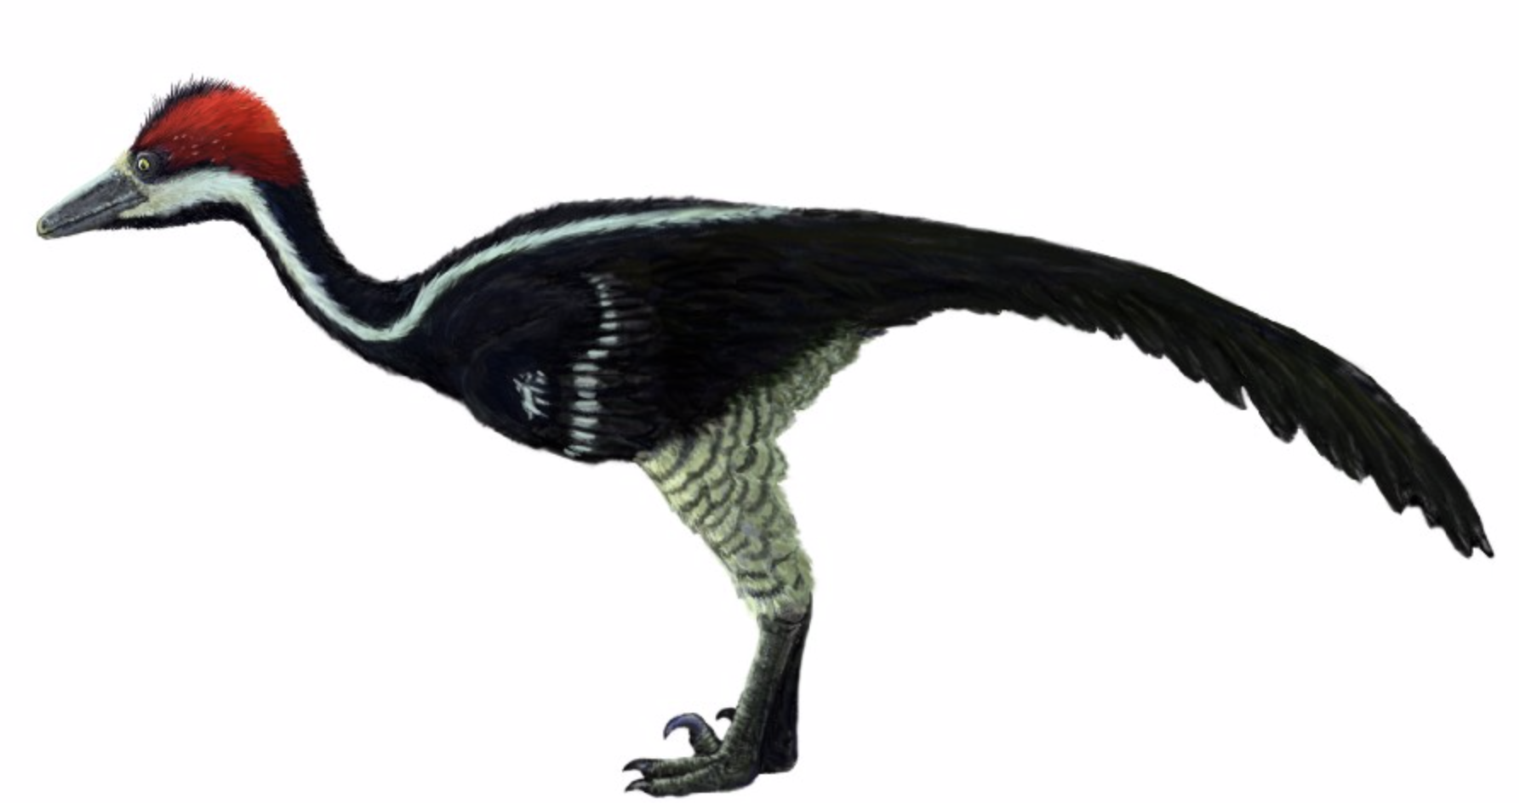
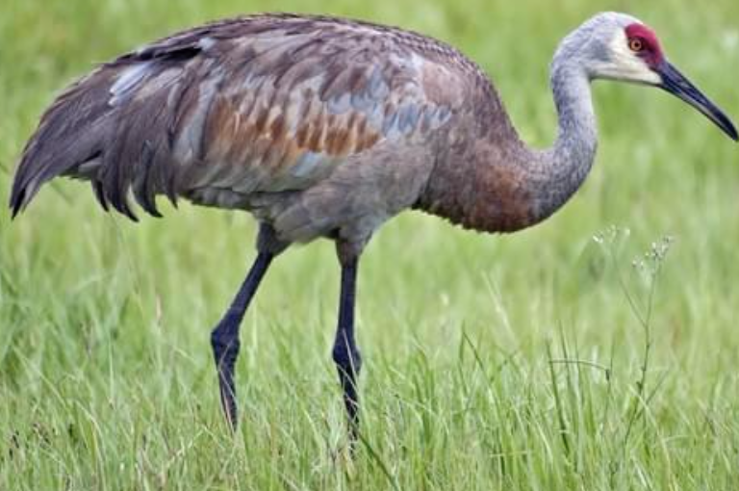
Zanabar Junior (L/I)
- Zanabar Junior was a non-avian that lived about 70 to 65 million years ago
- It was classified in multiple genus’ including theropoda
- They were carnivores that grew up to three meters long (about ten feet long)
- This species were known to live in terrestrial habitats in modern day Mongolia
- They were named after a Tibetan Buddhist Monk
- Zanabazar was originally discovered in 1974 by Rinchen Barsbold
Zanabar Junior
Sandhill Crane

Slide 14
Challenges & Solutions (S)
A challenge that we had was doubting yourself, we keep saying this is not an avian bird, then changing our minds.
Another challenge we had was creating the most efficient code without having so many errors
Getting incorrect results
We solved this by sticking to what we believed the most and coding go see if it backed up our answers
This was solved by going to hafter hours and getting help from Carol and the TA
Creating visualizations and re looking through the code

Slide 15
Next steps (N)
If we were to compare the ratios of brain measurements again, we would….
Include more brain measurements to increase accuracy
Create more graphs to allow for more in depth visualizations
Compare brain measurements, across multiple avian and non-avian species
Compare other factors, we could compare their bone density and bone marrow (tissue inside of bone) if the fossils were intact

Slide 16
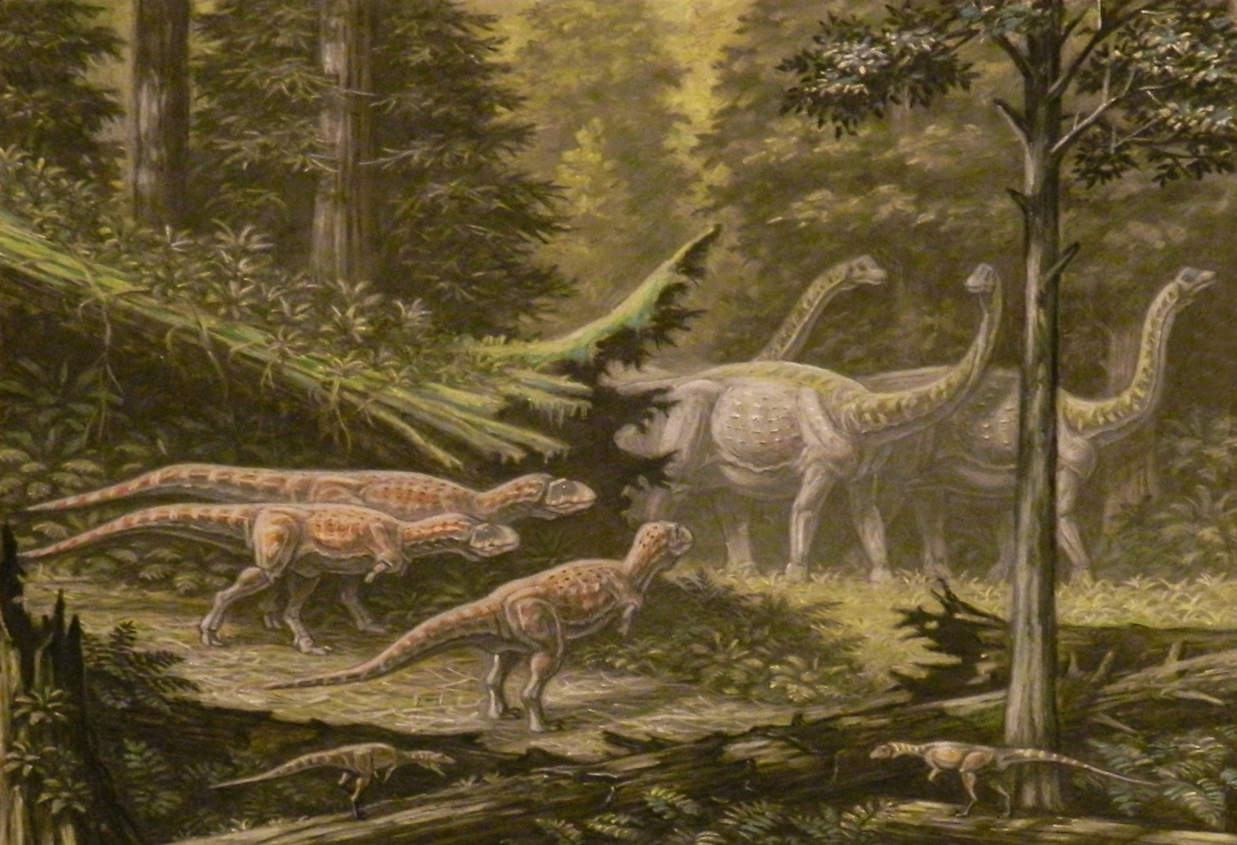
THE END ANY QUESTIONS?

